Slide 1

SCIENTIFIC CALCULATOR
16 March, 2024
Submitted By :-
Submitted To:-
-Nosin C. Adhikari(THA081BEI026)
-Oasis Paudel(THA081BEI027)
-Sujana Shrestha(THA081BEI045)
-Sumit Paudel(THA081BEI046)
Department of Computer and Electronics
Thapathali Campus

Slide 2
Introduction
A scientific calculator is an advanced computing tool capable of performing complex mathematical operations such as arithmetic, trigonometry, logarithms, exponents, and statistical functions.
Why Implement It in C?
C is a powerful and efficient programming language.
It provides fast execution.
It allows implementation of mathematical functions .
Objective of the Project
To develop a scientific calculator .
To enhance problem-solving skills using C programming.
To demonstrate functions, loops, conditionals, and user input handling.
2

Slide 3
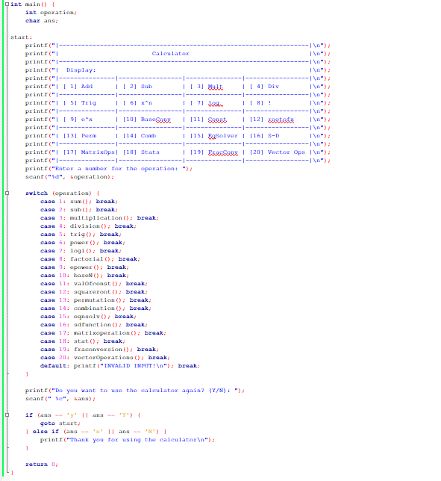
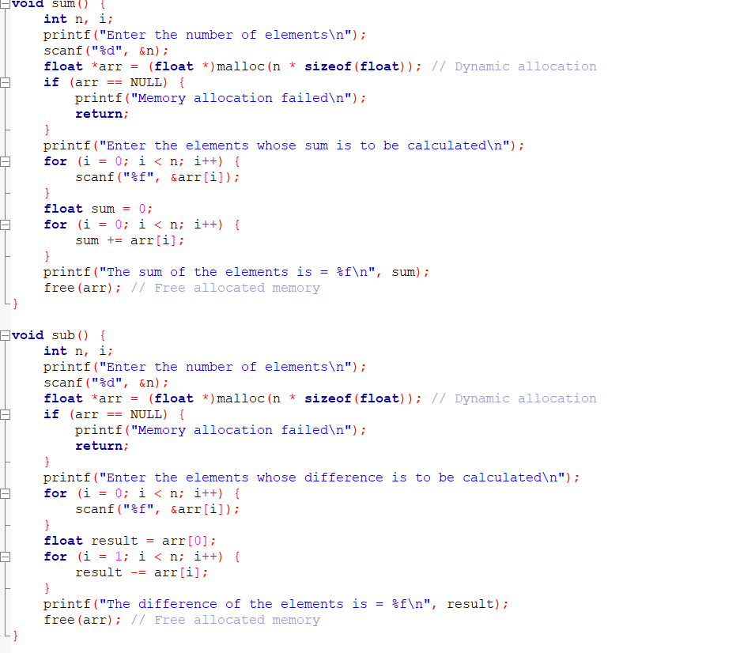
Main , sum & sub function
3

Slide 4
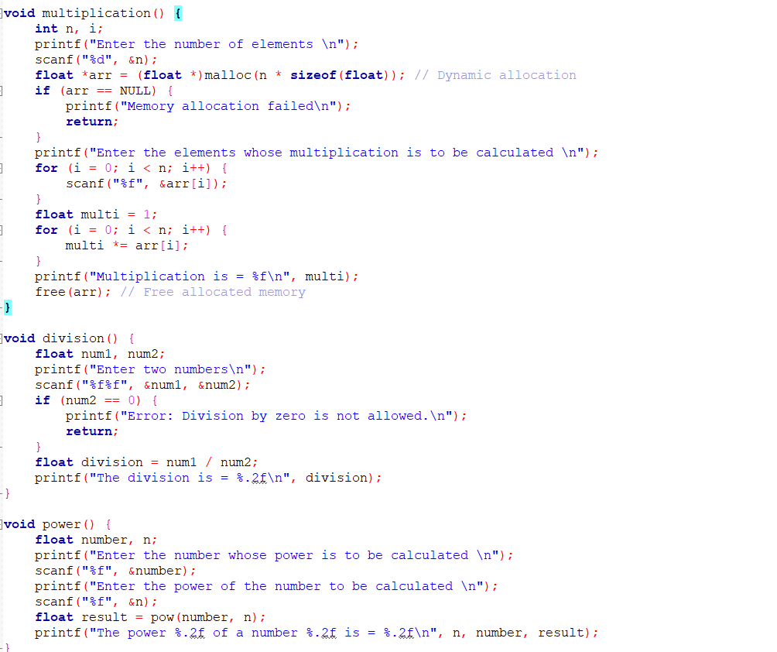
Multiplication ,division & power function
4

Slide 5
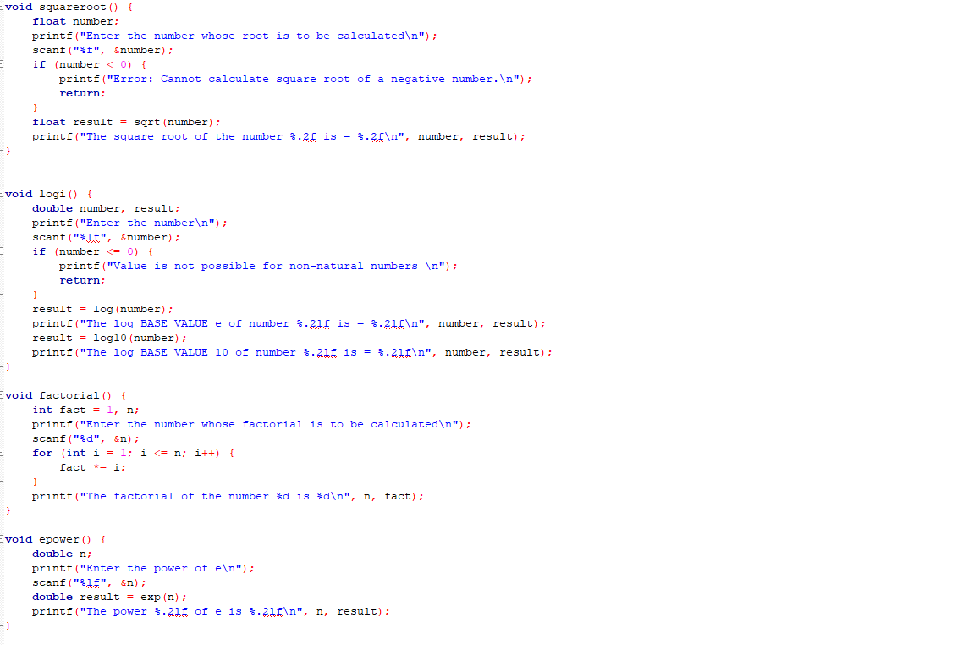
Power ,log ,factorial & epower function
5

Slide 6
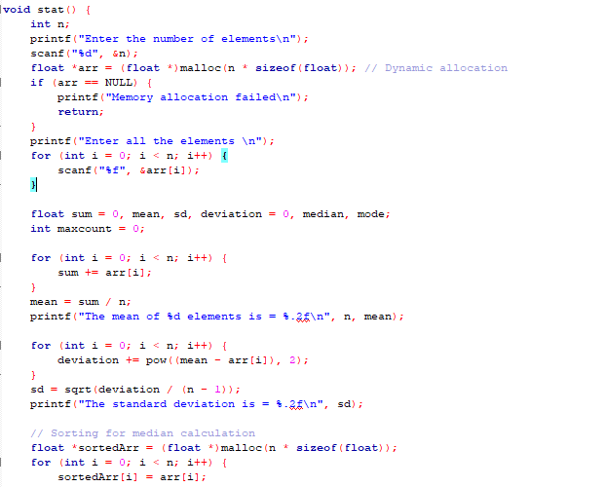
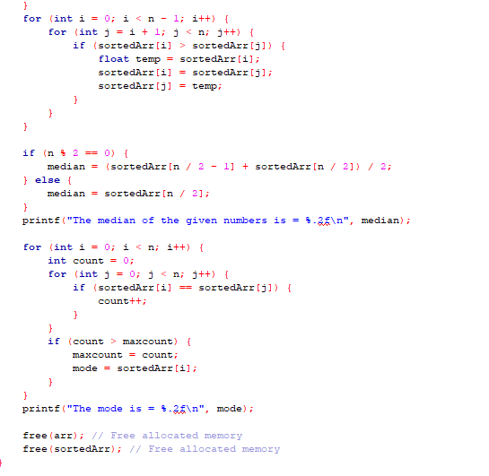
Statistics function
6

Slide 7
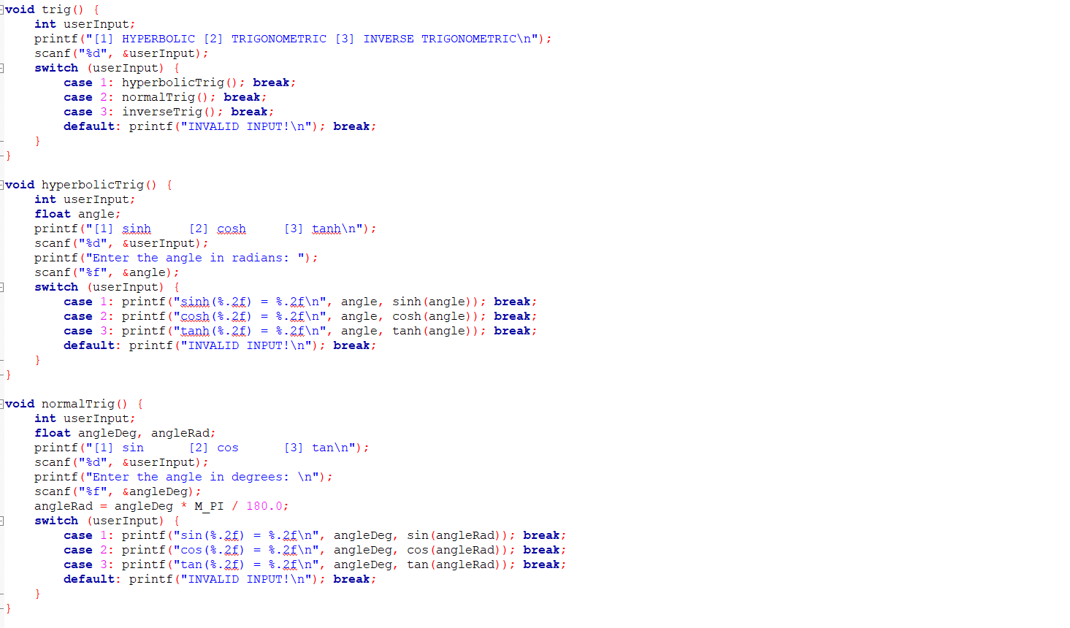
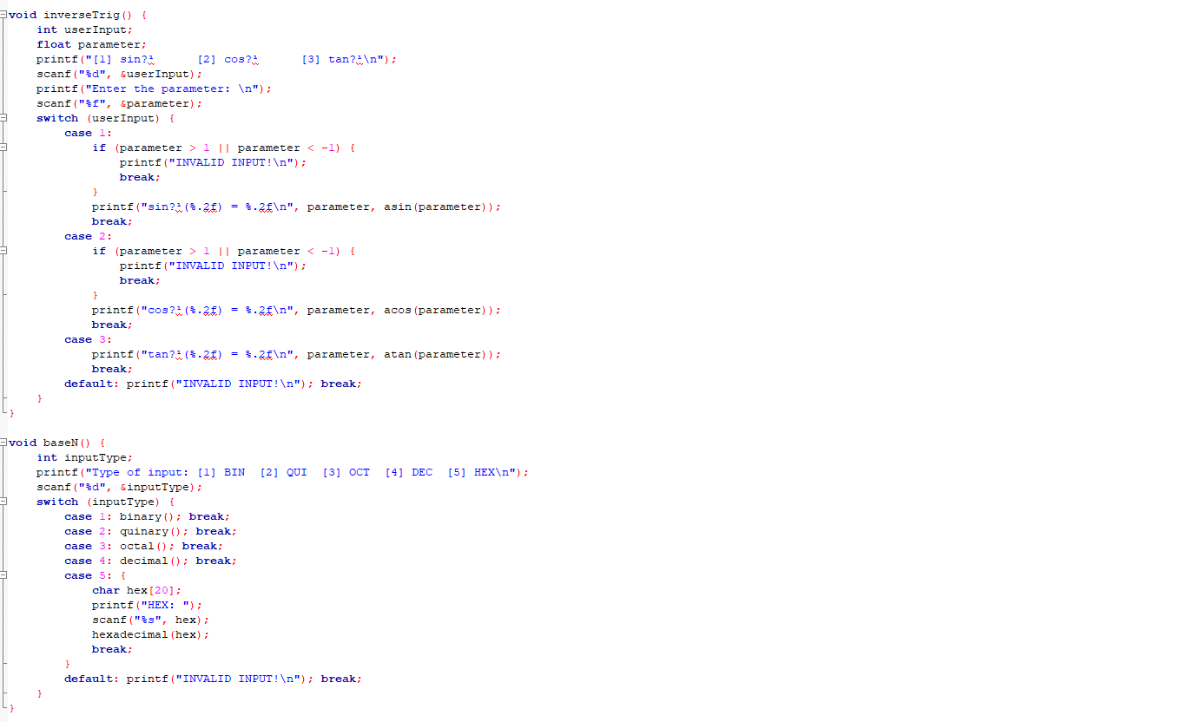
Trigonometric and base conversion function
7

Slide 8
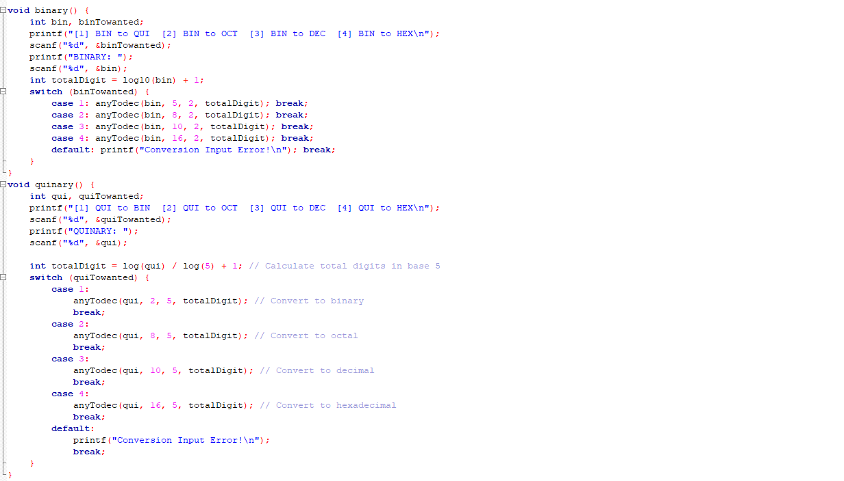
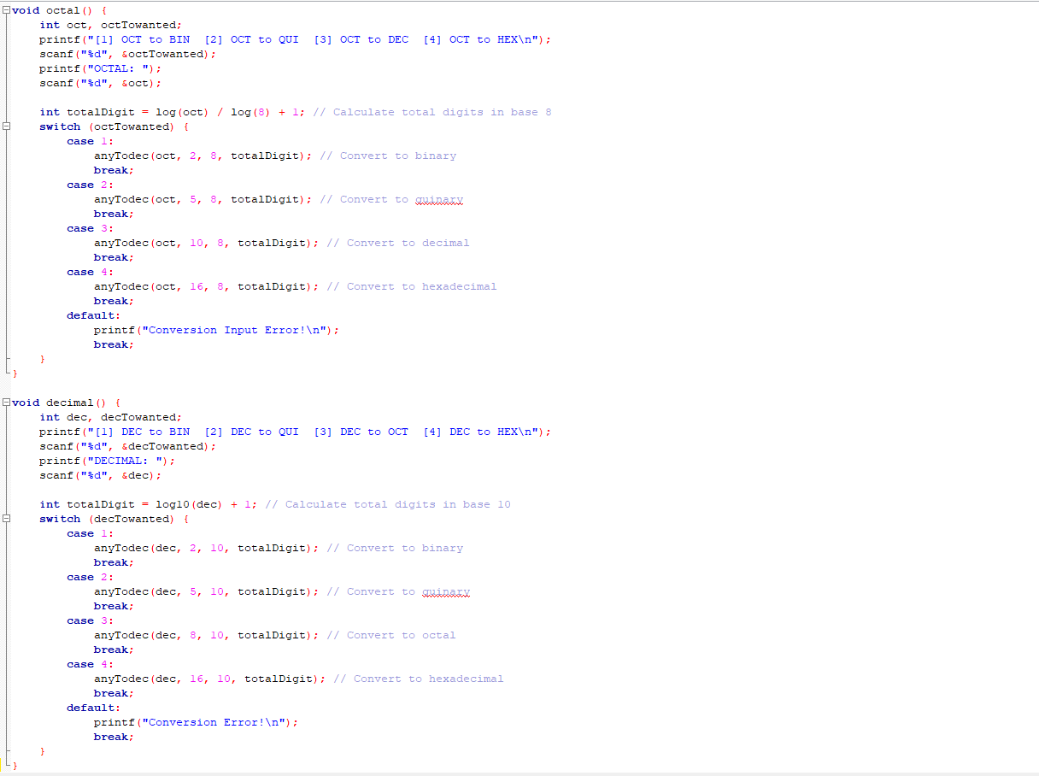
Base conversion function
8

Slide 9
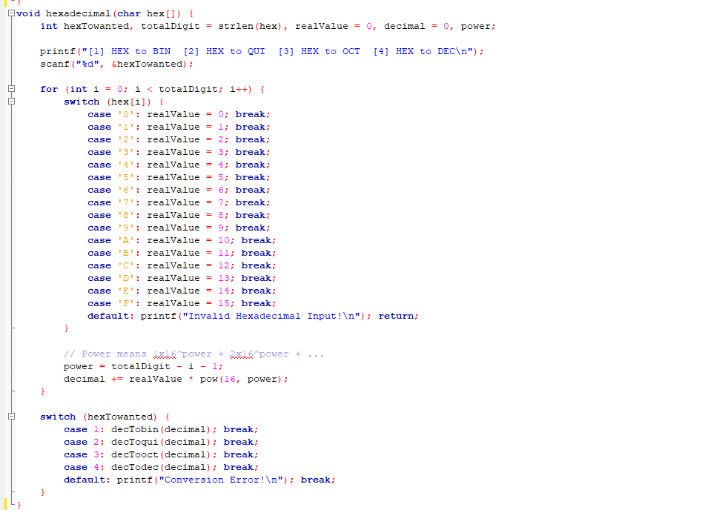
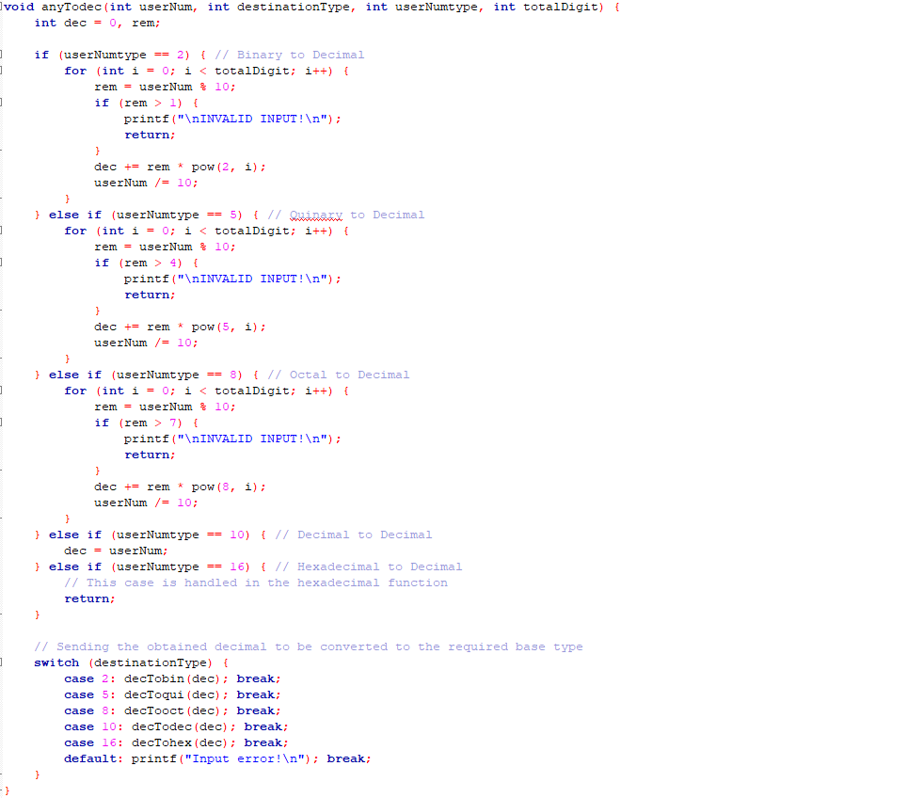
Base conversion function
9

Slide 10
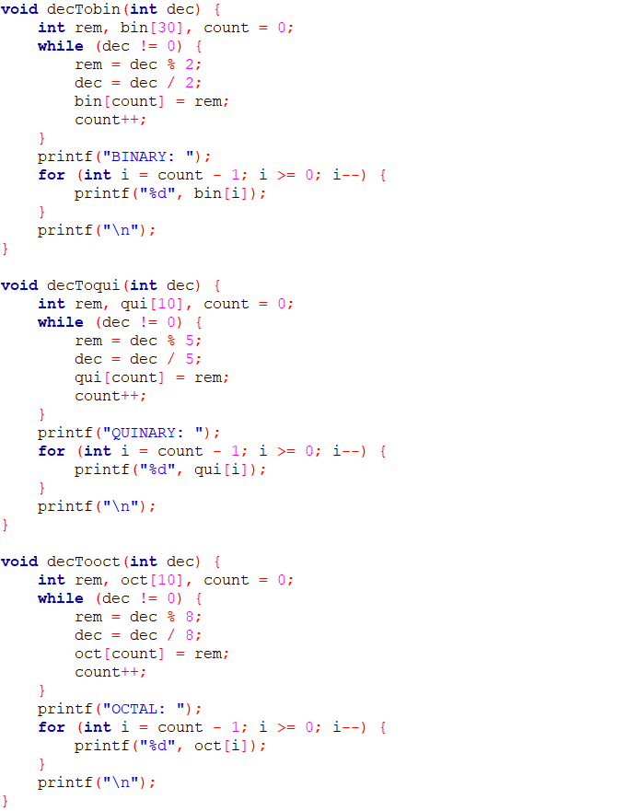
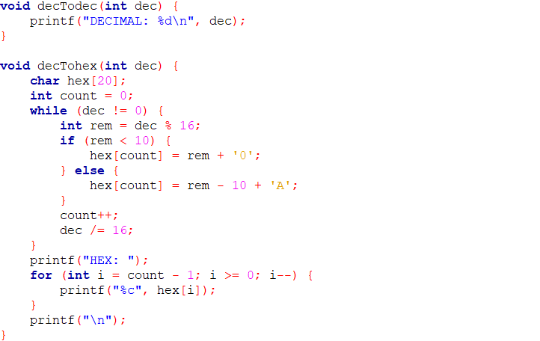
Base conversion function
10

Slide 11
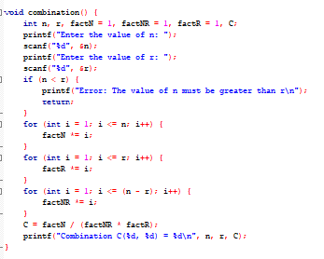
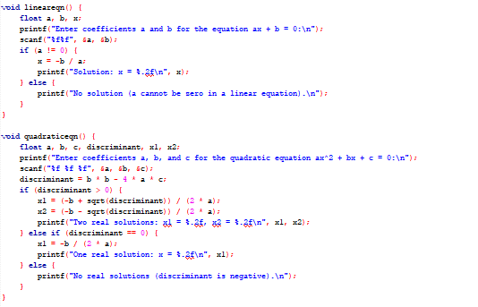
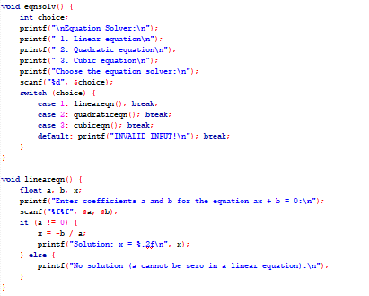
Combination & Equation solver function
11

Slide 12
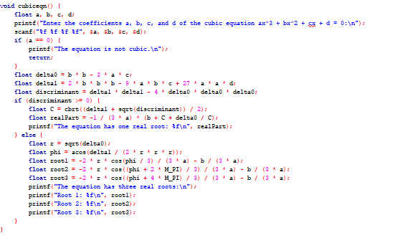
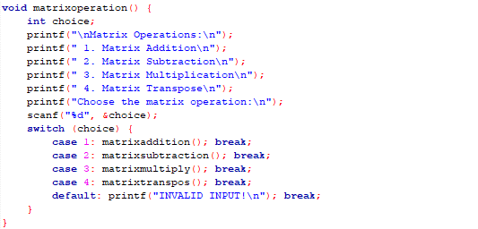
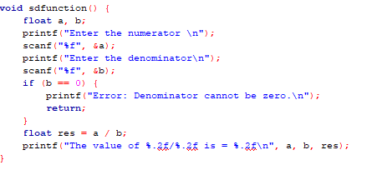
Equation solver ,S-D , matrix operation function
12

Slide 13
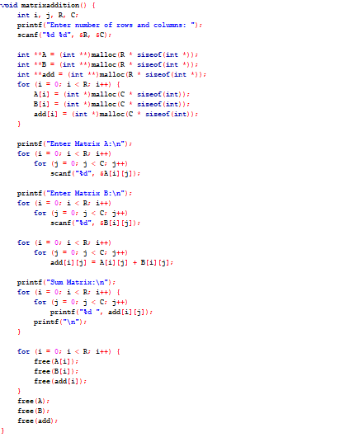
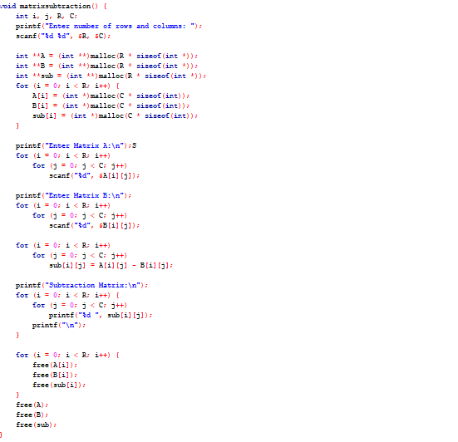
Matrix operation function
13

Slide 14
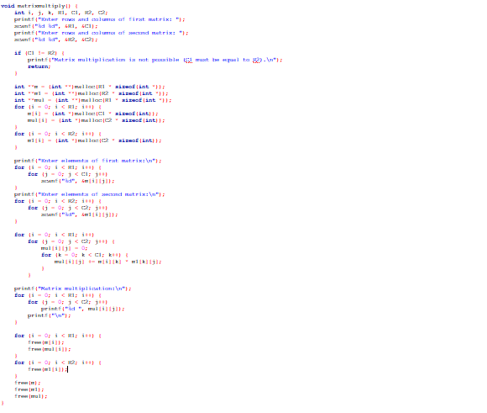
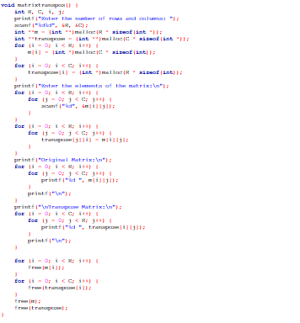
Matrix operation function
14

Slide 15
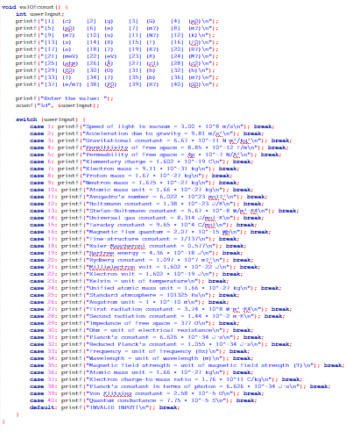
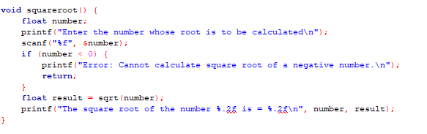
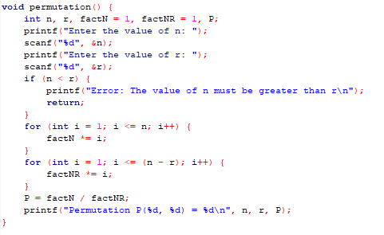
Value of constant , squareroot & permutation function
15

Slide 16
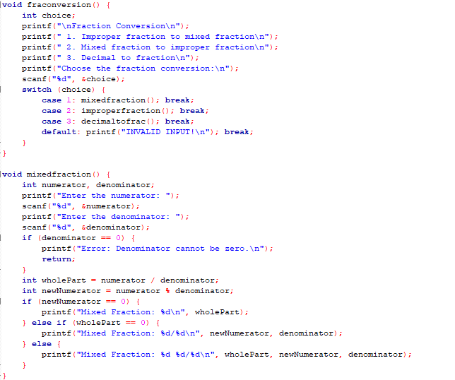
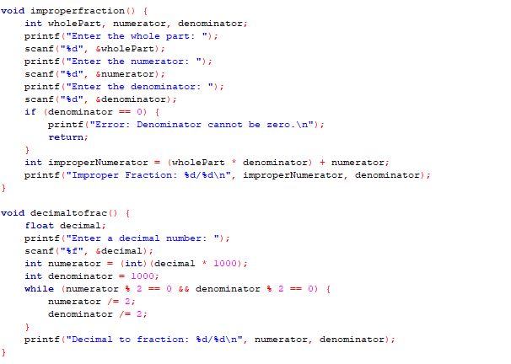
Fraction to decimal conversion function
16

Slide 17
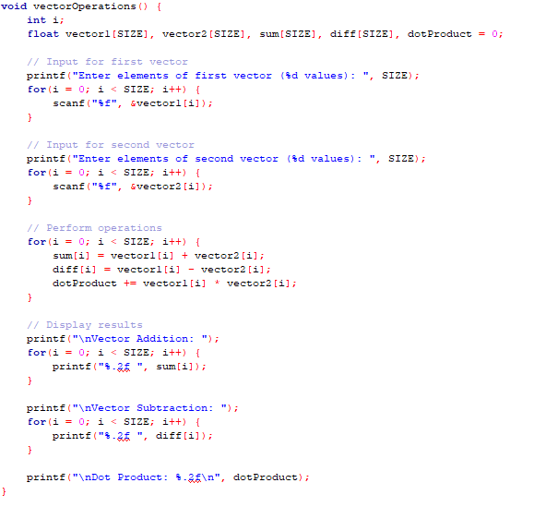
Vector operation function
17

Slide 18
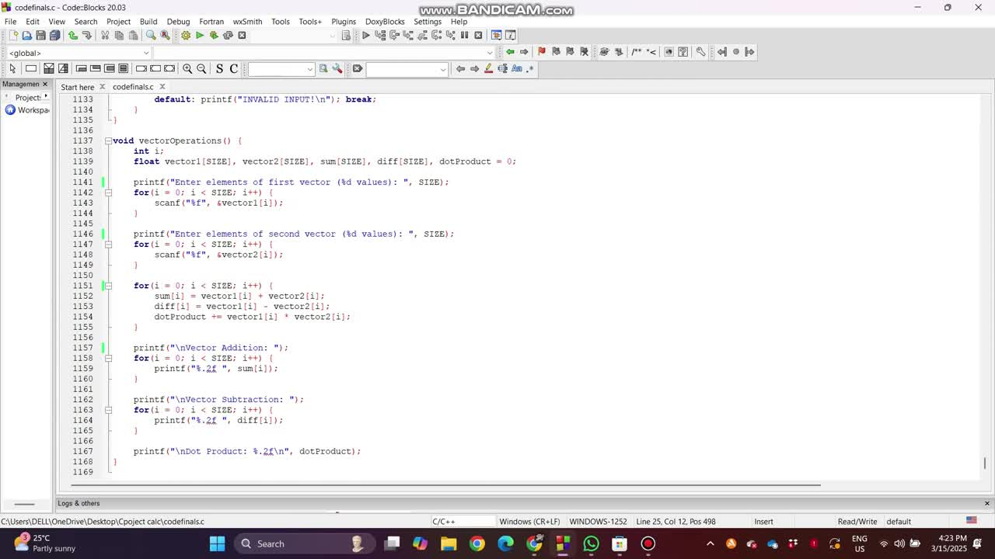
Demo video
18

Slide 19
Conclusion
In conclusion, developing a scientific calculator in C demonstrates the power and flexibility of the C programming language in handling complex mathematical operations. Through the implementation of functions for arithmetic, trigonometry, logarithms, exponentiation, and more, we can create an efficient and user-friendly tool for performing various calculations.
This project not only enhances our understanding of C programming concepts, such as functions, loops, conditional statements, and memory management, but also improves problem-solving skills by applying mathematical logic to real-world applications.
19

